Slide 1

HTML Basic
HTML Introduction

Slide 2
Information
Agenda
System
01
How the Web Works
Explanation on Web mechanism
02
What is a Web Page?
Variant of Web Page
03
My First Web Page
First time in Web Programming
04
Basic of HTML
Understanding the Structure of HTML

Slide 3
How the Web Works
Explanation on the Web Mechanism

Slide 4

About Web
Web page: a specific collection of information provided by a website and displayed to a user in a web browser
www.hufs.ac.kr
Website: a collection of web pages that is accessible through web browser

Slide 5

About Web
Web browser: a software application for accessing information on the World Wide Web (www).
The website will be opened in a web browser in accordance to the web browser requirement. For example, Safari is the default web browser for IoS and Internet Explorer is the default web browser for Windows

Slide 6
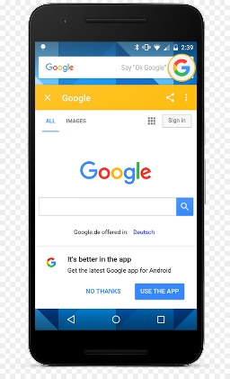



How the Web Works?
World Wide Web (WWW) use classical client / server architecture
  HTTP is text-based request-response protocol
HTTP
Page request
HTTP
Server response
Server running Web Server Software (IIS, Apache, etc.)
Client running a Web Browser

Slide 7
What is a Web Page?
Variant of Web Pages

Slide 8
What is a Web Page?
Web pages are text files containing HTML
HTML – Hyper Text Markup Language
  A notation for describing
    document structure (semantic markup)
    formatting (presentation markup)
  Looks (looked?) like:
    A Microsoft Word document
The markup tags provide information about the page content structure

Slide 9
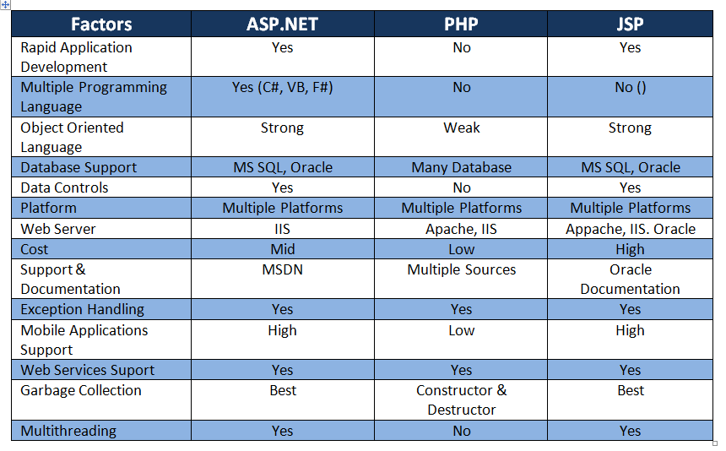
What is a Web Page?
http://forhadparvez.blogspot.com/2017/03/aspnet-vs-php-vs-jsp.html

Slide 10
Creating HTML Pages
WYSIWYG: What You See Is What You Get
An HTML file must have an .htm or .html file extension
HTML files can be created with text editors:
  NotePad, NotePad ++, PSPad
HTML editors (WYSIWYG Editors):
  Microsoft FrontPage
  Macromedia Dreamweaver
  Netscape Composer
  Microsoft Word
  Visual Studio
HTML Online editors
  https://html-online.com/editor/
  https://www.w3schools.com/tryit/
  https://html5-editor.net/

Slide 11
Learning Check
How does the Web works?
What is HTML?
What is the different among them: ASP.net, ASP, and JSP?

Slide 12
My First Web Page
My first HTML file

Slide 13
HTML Structure
HTML is comprised of “elements” and “tags”
  Begins with <html> and ends with </html>
Elements (tags) are nested one inside another:
Tags have attributes:
HTML describes structure using two main sections: <head> and <body>
<html> <head></head> <body></body> </html>
<img src="logo.jpg" alt="logo" />

Slide 14
HTML Code Formatting
The HTML source code should be formatted to increase readability and facilitate debugging.
  Every block element should start on a new line.
  Every nested (block) element should be indented.
  Browsers ignore multiple whitespaces in the page source, so formatting is harmless.
For performance reasons, formatting can be sacrificed

Slide 15
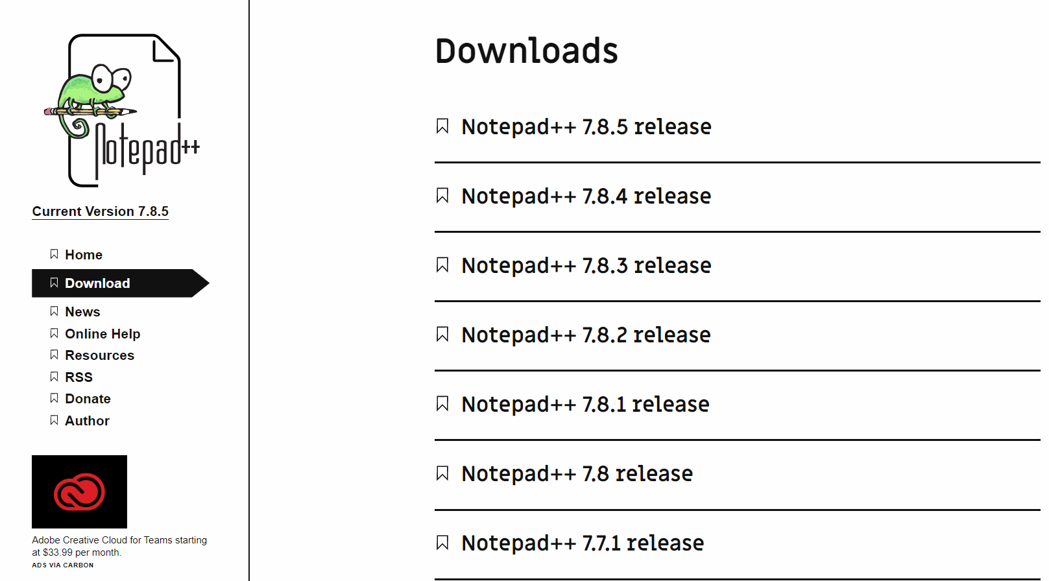
HTML Editor
For the beginning of this course, I will use Notepad++
  https://notepad-plus-plus.org/downloads/
Or, you can use online editor for your convenience

Slide 16
First HTML Page
test.html
For the first time, we can open a new editor.
Copy and paste the code on the right panel
Save the file and write a name “test.html”.
Double click on the file and see the result on your web browser.
<!DOCTYPE HTML>
<html>
<head>
<title>My First HTML Page</title>
</head>
<body>
<p>This is some text...</p>
</body>
</html>

Slide 17
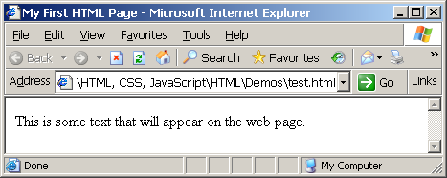
First HTML Page
test.html
<!DOCTYPE HTML>
<html>
<head>
<title>My First HTML Page</title>
</head>
<body>
<p>This is some text...</p>
</body>
</html>

Slide 18
First HTML Page
Tags
Start with <HTML> and end with </HTML>
Header
Body

Slide 19
First HTML Page: Tags
<!DOCTYPE HTML>
<html>
<head>
<title>My First HTML Page</title>
</head>
<body>
<p>This is some text...</p>
</body>
</html>
Opening tag
Closing tag
An HTML element consists of an opening tag, a closing tag and the content inside.

Slide 20
First HTML Page: Header
HTML header
<!DOCTYPE HTML>
<html>
<head>
<title>My First HTML Page</title>
</head>
<body>
<p>This is some text...</p>
</body>
</html>

Slide 21
First HTML Page: Body
<!DOCTYPE HTML>
<html>
<head>
<title>My First HTML Page</title>
</head>
<body>
<p>This is some text...</p>
</body>
</html>
HTML body

Slide 22
Basic of HTML
My first HTML file

Slide 23
Headings and Paragraphs
Heading Tags (h1 – h6)
Paragraph Tags
Sections: div and span
<h1>Heading 1</h1>
<h2>Sub heading 2</h2>
<h3>Sub heading 3</h3>
<p>This is my first paragraph</p>
<p>This is my second paragraph</p>
<div style="background: skyblue;">
This is a div</div>

Slide 24
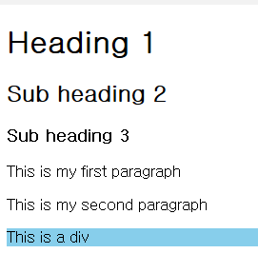
Headings and Paragraphs – Example
headings.html
<!DOCTYPE HTML>
<html>
<head><title>Headings and paragraphs</title></head>
<body>
<h1>Heading 1</h1>
<h2>Sub heading 2</h2>
<h3>Sub heading 3</h3>
<p>This is my first paragraph</p>
<p>This is my second paragraph</p>
<div style="background:skyblue">
This is a div</div>
</body>
</html>

Slide 25
The <head> Section
Contains information that doesn’t show directly on the viewable page
Starts after the <!doctype> declaration
Begins with <head> and ends with </head>
Contains mandatory single <title> tag
Can contain some other tags, e.g.
  <meta>
  <script>
  <style>
  <!–- comments -->

Slide 26

<head> Section: <title> tag
Title should be placed between <head> and </head> tags
Used to specify a title in the window title bar
Search engines and people rely on titles
<title> HUFS IME </title>

Slide 27
<head> Section: <meta>
Meta tags additionally describe the content contained within the page
<meta name="description" content="HTML tutorial" />
<meta name="keywords" content="html, web design, styles" />
<meta name="author" content="Bernardo" />
<meta http-equiv="refresh" content="5; url=http://www.google.com" />

Slide 28
<head> Section: <script>
The <script> element is used to embed scripts into an HTML document
  Script are executed in the client's Web browser
  Scripts can live in the <head> and in the <body> sections
Supported client-side scripting languages:
  JavaScript (it is not Java!)
  VBScript
  Jscript (previously known as ECMAScript)

Slide 29
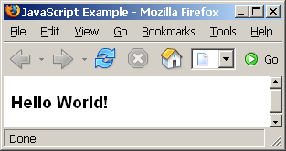
The <script> Tag – Example
scripts-example.html
<!DOCTYPE HTML>
<html>
<head>
<title>JavaScript Example</title>
<script type="text/javascript">
function sayHello() {
document.write("<p>Hello World!<\/p>");
}
</script>
</head>
<body>
<script type=
"text/javascript">
sayHello();
</script>
</body>
</html>

Slide 30
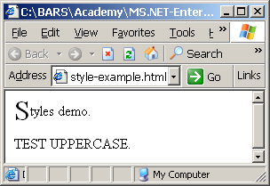
<head> Section: <style>
The <style> element embeds formatting information (CSS styles) into an HTML page
style-example.html
<html>
<head>
<style type="text/css">
p { font-size: 12pt; line-height: 12pt; }
p:first-letter { font-size: 200%; }
span { text-transform: uppercase; }
</style>
</head>
<body>
<p>Styles demo.<br />
<span>Test uppercase</span>.
</p>
</body>
</html>

Slide 31
Comments: <!-- --> Tag
Comments can exist anywhere between the <html></html> tags
Comments start with <!-- and end with -->
<!–- Show the HTML -->
<!–- Hyperlink to the web site -->
<a href="http://google.com/">Google</a>
<!–- Show the website -->
...

Slide 32
Next
We will learn more on the BODY section

